Slide 1

The art of phishing

Slide 2
PRESENTATION INTRODUCTION
What is in this presentation ?
Spear phishing
Power grid attacks started with phishing
Identity kidnapping started with phishing
What will you learn by the end of this presentation ?
General awareness about phishing
How to Improve the security of your future company against phishing attacks
Realise the potential of these attacks and the risk involved

Slide 3
PHISHING
What is phishing ?
Definition¹:
Type of attack: email
Targets: Database of emails, specific individuals, organisations and businesses.
Intention: Steal data for malicious purposes, install malware, redirect to spoofed websites or simply scam users.
Types of phising:
Spear, cloning, whaling,…
[ 1 ] https://en.wikipedia.org/wiki/Phishing

Slide 4
1.
SPEAR PHISHING

Slide 5
SPEAR PHISHING
Famous examples ?
RSA Security firm 2011
2 targeted emails to 4 workers. Such a high level of crafting that 1 employee retrieved one of the emails out of the junk folder and spread a malware into the company’s network.
Oak Ridge National Laboratory
1 targeted email from the “HR” department to 530 employees, 57 clicked on the link and 2 got infected. All the network ended up infected.

Slide 6
SPEAR PHISHING
Why do you become a target?
Web presence
Social networks
Personal page
Email
Friend’s list
Recent post
Company’s website
Position
Co-workers
Internal information

Slide 7
CURRENT CONSEQUENCES OF SPEAR PHISHING
Very effective and hard to detect:
1 mistake from 1 employee
Cleverly customized
Consequences:
Stolen data: commercially sensitive information, stock price manipulation, espionnage, credentials, ...
Malware deployment: APT, Botnets, ...
Foothold for the next step: information about customers, executives, other personnel.

Slide 8
FUTURE OF SPEAR PHISHING
Possible factors that might influence spear phishing?
Recognised by companies as a main threat
Better personnel training
Better filtering and countermeasures
New emerging scams will emerge
Forging online shopping sites with low prices (CC)
Great impact on online sales because of trust issues from any real store

Slide 9
NUMBERS
Proof that they work?
Opened emails : 3% spam vs 70% of spear
Clicked links: 5% spam vs 50% spear
A 10 spear email attack has a 90% rate of success
Volume ?
205B mails/day by 4.3B users
121 mails/day per office worker
2.3% of emails are malicious
2.8 malicious mails/day per office worker !!!

Slide 10
2.
POWER GRIDS

Slide 11
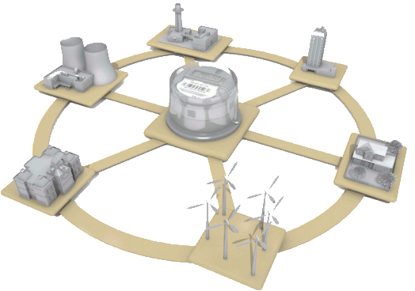
Power/Smart Grids
Phishing impact
on

Slide 12
Ukraine’s Power Grid attack
December 23, 2015
Hackers carefully planned their assault over months
In spring, the attackers began a spear phishing campaign targeting IT staff and system administrators
Delivered emails to workers at three companies with malicious Word documents attached
Machines were infected and opened a backdoor to the hackers
Hackers broke circuits, reconfigured UPS, replaced firmwares of serial-to-Ethernet converters, and started a TDoS attack.
About 700.000 people had no power for several hours

Slide 13
Power grid attack history
2000: Russian gas extraction company OJSC (Trojan)
2001: California‘s power distribution center (Web server)
2003: Ohio nuclear power plant (Slammer worm)
2008: Multiple cities outside the US were cut off (unknown)
2010: Iranian nuclear facility (Stuxnet)
2013: Part of Austrian and German power grid nearly broke down (misdirected Command)
2014: German Steel Mill Cyber Attack (Spear Phishing, Social Engineering)
2015: Ukraine‘s power grid attack (Spear Phishing, Black Energy Trojan, Killdisk)
2016, 04: German nuclear plant (Conficker, W32.Ramnit) (No risk, malware required internet access)
2016, 04: Board of Water and Light, Michigan (Ransomware attack)

Slide 14
Current risks and consequences of power grid phishing attacks

Slide 15
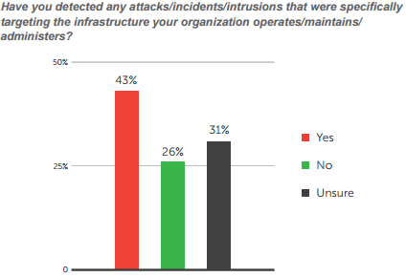
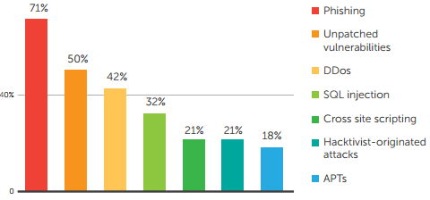
Critical infrastructure attack survey
Phishing is the most used cyber attack method against critical infrastructures.
26% were sure they were not attacked, 74% were either not complete sure, or pretty sure that those attacks have happened to their company

Slide 16
Main threat vectors
IT network
Insider
Tampered equipment and software
How to protect Critical Infrastructure:
All three attack vectors must be addressed.

Slide 17
Future threats and developments

Slide 18
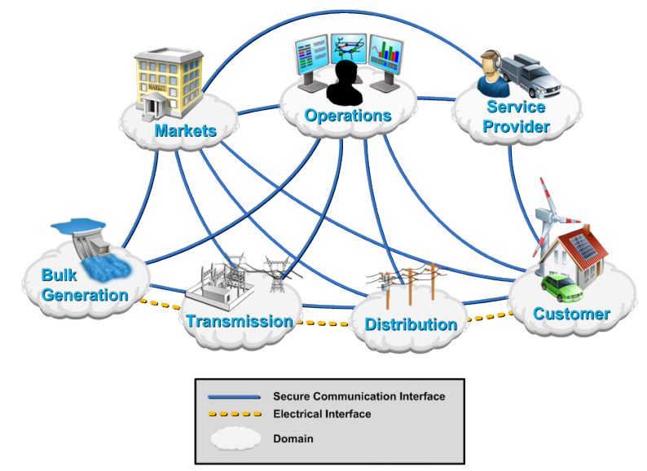
Smart Grids: Conceptual Model

Slide 19
Existing grids/Smart grids: Comparison
Existing Grid | Smart Grid
Electromechanical | Digital
One-way communication | Two-way communication
Centralized | Distributed generation
Few sensors | Sensors throughout
Manual monitoring | Self-monitoring
Manual restoration | Self-healing
Failures and blackouts | Adaptive and islanding
Limited control | Pervasive control
Few customer choices | Many customer choices

Slide 20
Smart grids: Key and future threats, developments
Key Threats
Attacks on the infrastructure
Everyday malware and zero-days
Spear phishing, watering hole attacks and social engineering
Insiders
Could cause a International, Cross Border, National or Regional power outage or damage to infrastructure
Future Threats and Developments
Expecting attacks to increase in quantity and quality
Growing threat of ransomware
Rethinking of security, incorporating security-by-design into hard- and software components
Improved vulnerability and patch management

Slide 21
Smart Meters: Risk, threats and vulnerabilities
Consumer concerns over privacy (data usage by law enforcement)
Social concerns over „fair“ availability of electricity
Complex rate systems remove clarity and accountability.
Remotely controllable „kill switch“ incorporated into most smart meters
Giving the government mechanisms to control the use of all power using activities

Slide 22
Smart Meters in the UK
4.2 million smart and advanced meters operating across homes and businesses in Great Britain (30 June 2016)
A total of 639,300 smart and advanced meters were installed in Q2 2016
The Smart Metering programme aims to roll-out over 50 million smart gas and electricity meters in Great Britain by the end of 2020

Slide 23
3.
IDENTITY KIDNAPPING

Slide 24

Digital Identity Kidnapping

Slide 25
How does it start?
First, personal information is retrieved using phishing emails.
Then the personal details stolen is used to access the social media accounts of the respective person/s
After accessing the social media accounts, the attacker would steal photos of yourself or your child and misuse or abuse them.

Slide 26

Consequences
Role playing as a fictional person or a parent of a child.
Unwanted attention
Misusing of stolen photos in a bad way could affect the victim psychologically
Once it is misused, it is hard to take it back or correct it.

Slide 27

How will it improve in the future? – An Attack on you
Tamper with financial information
An attack could be directed on a specific person.
For example, an attacker could delete your existence from a database or a system which can cause serious harm.

Slide 28
Conclusion and Countermeasures
Phishing is the most used technique to engage in cyber crime.
There’s no way of avoiding phishing for good.
General Awareness regarding phishing and cybercrime would be helpful.
Prevention is better than cure.

Slide 29
Thank You
Any Questions?

